Slide 1
Machine vision – Moving Window
Dr. Mikael Ericsson
2025
Notes:
Exempelsidorna som följer visa hur layouten är tänkt med bilder och layoutflöde.
Under ”Ny bild”¹ finns fler layoutmallar² än de som ligger på exempelsidorna nedan.
1.
2.

Slide 2
Types of neibourhood
4 neighbours
8 neighbours

Slide 3
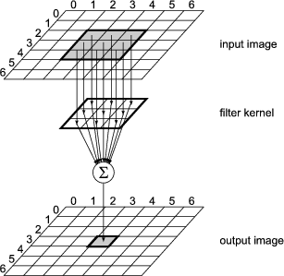
Moving window
Input image
Filter kernel
Output image

Slide 4
Border effects - Images borders are a problem
Image cropping. Problem: reduced output image.
Set border pixel. Problem: creating false edges.
Use available pixels. Working fine for rectangular filters.
Repeat valid border pixels.

Slide 5
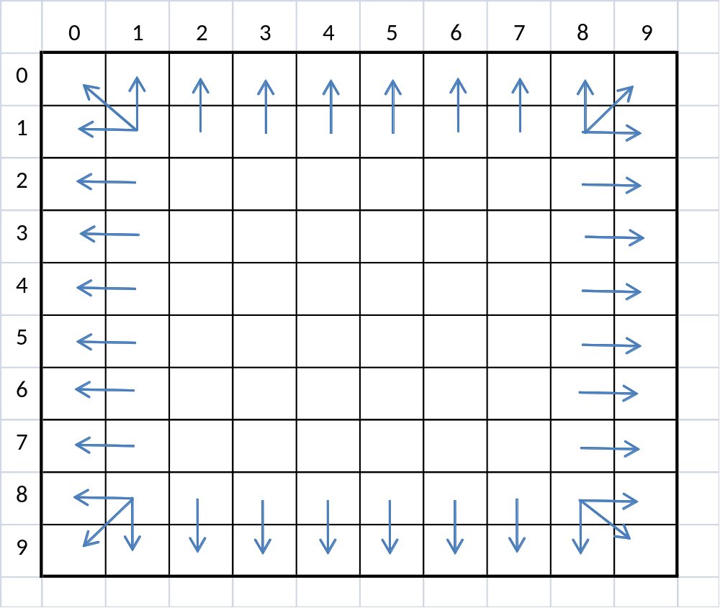
Border effects - repeated values

Slide 6
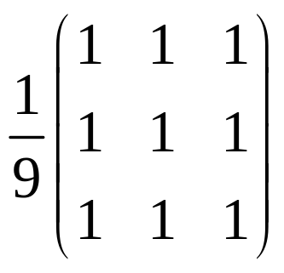
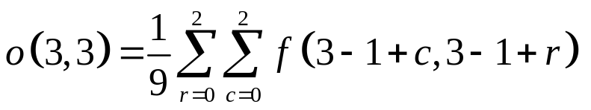
Smoothing filter
Low pass filter used to suppress noise
Are based on average
Scaling factor h(m,n) sets to 1
Destroys edges
Can be customized

Slide 7
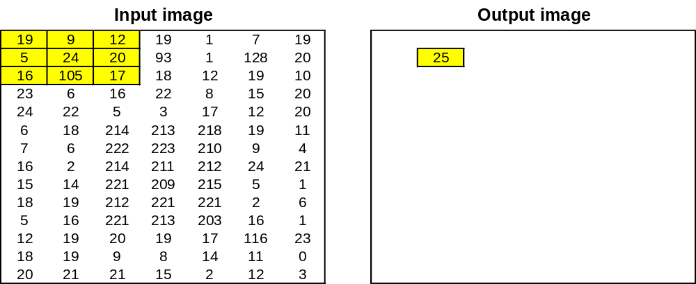
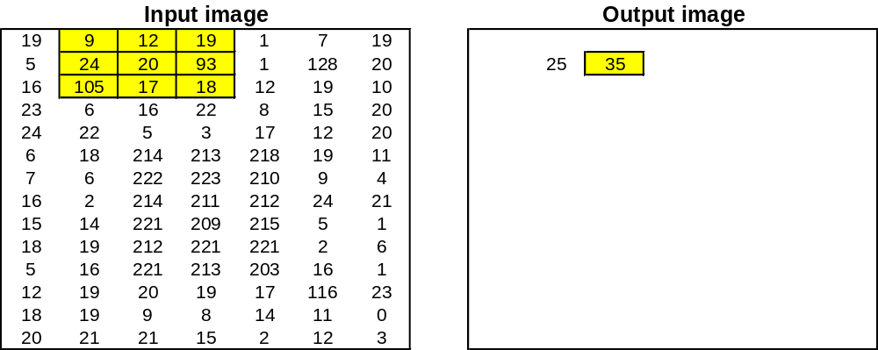
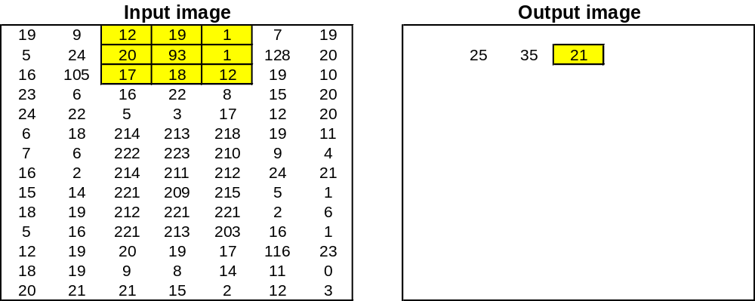
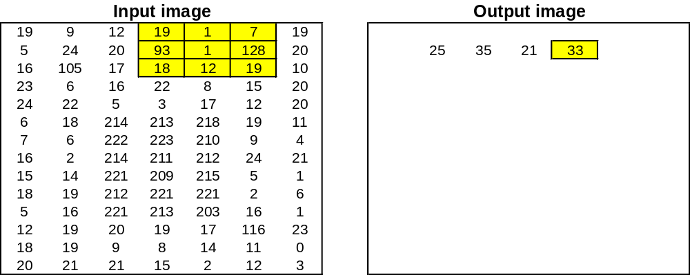
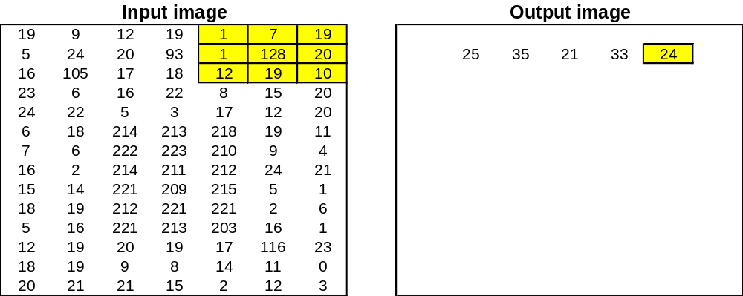
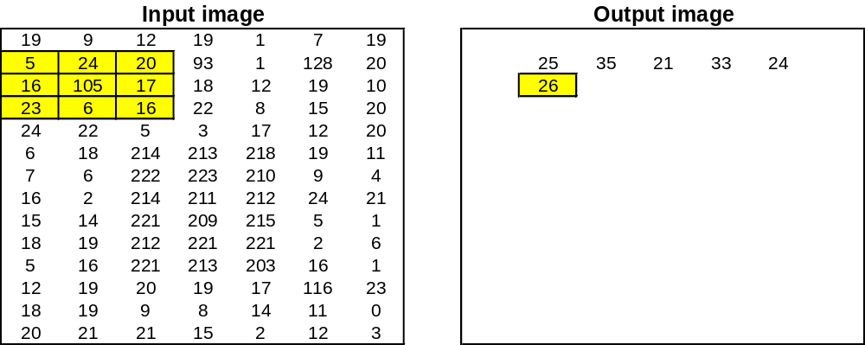
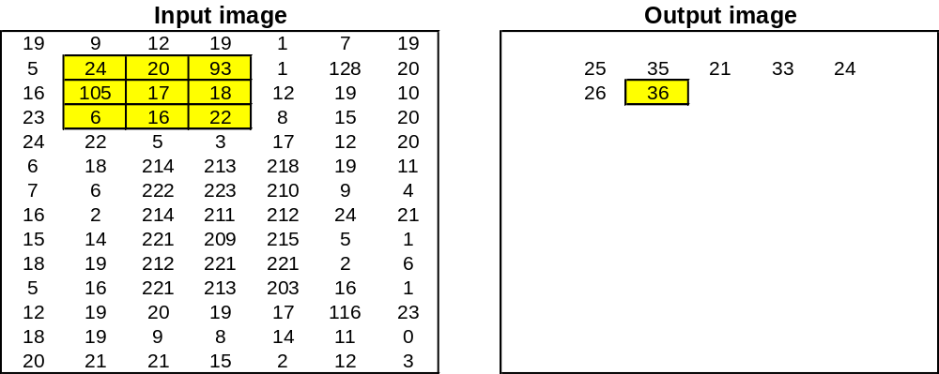
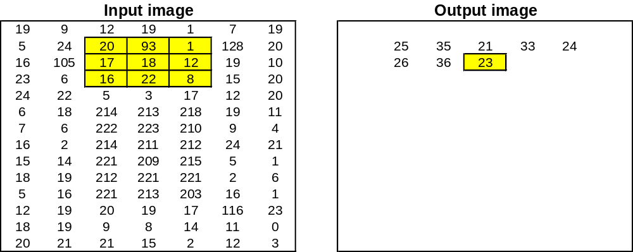
Moving window

Slide 8
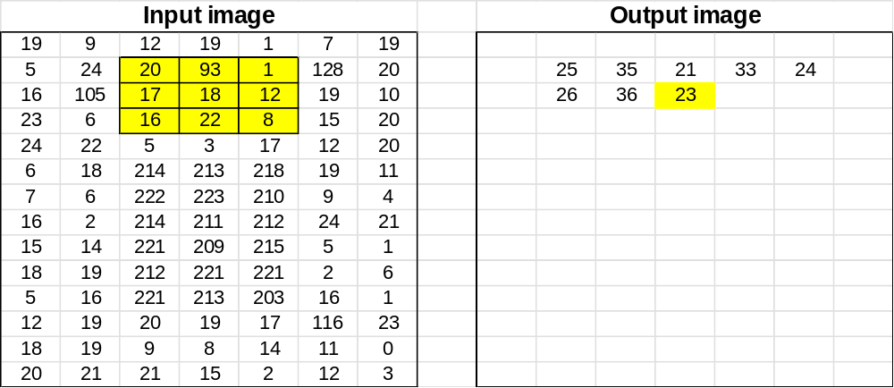
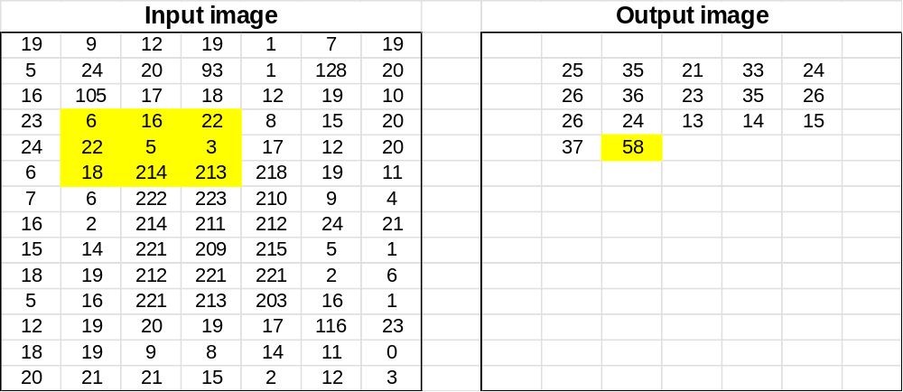
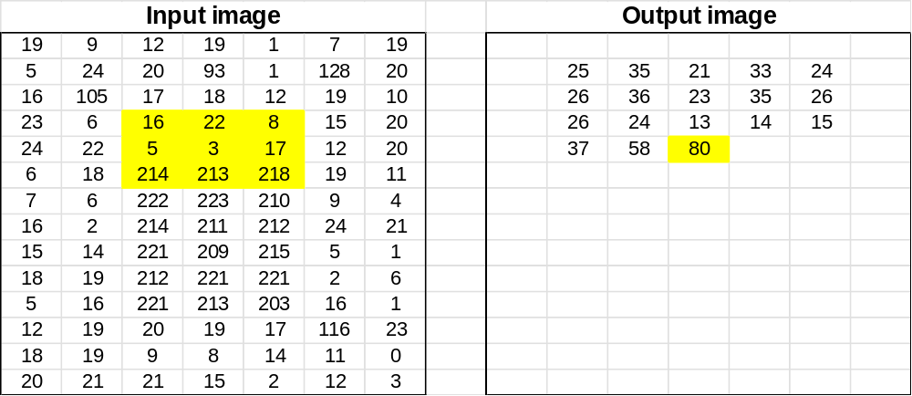
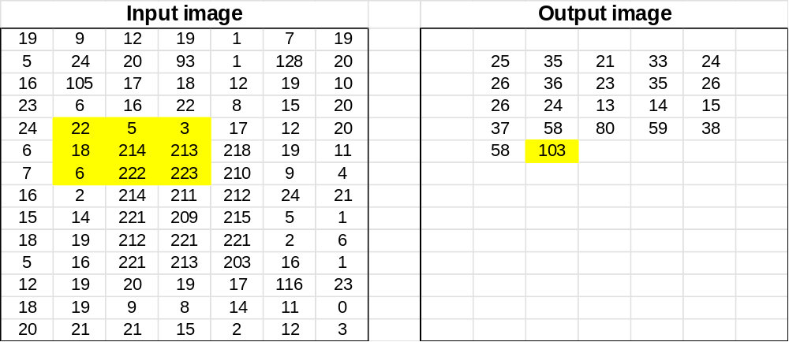
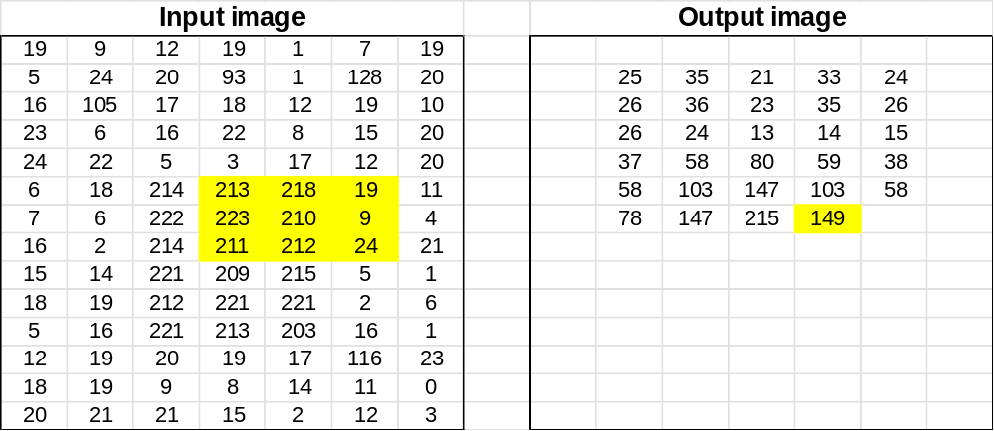
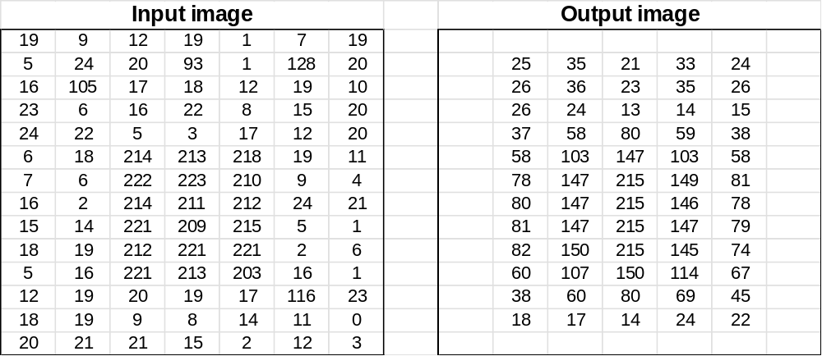
Average filter – Interesting points

Slide 9
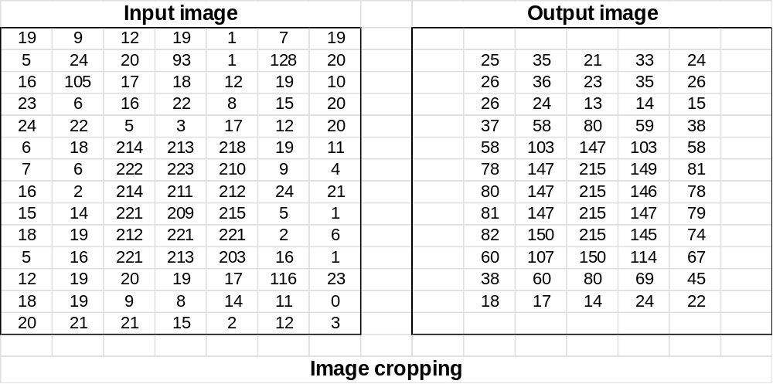
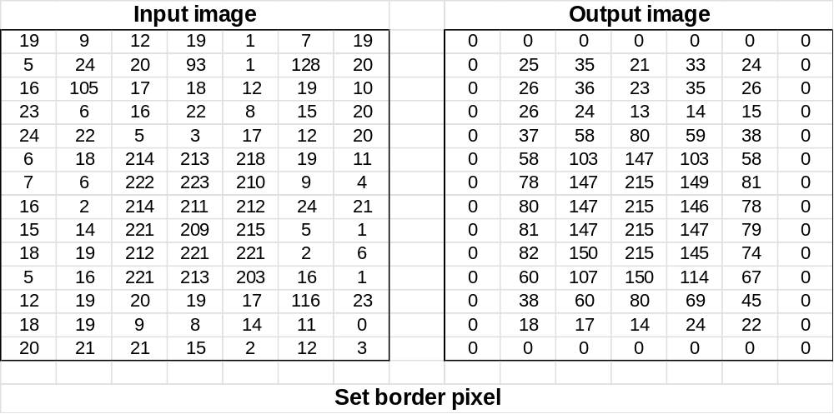
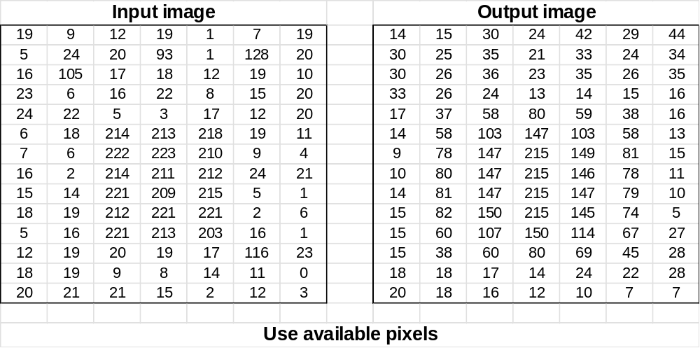
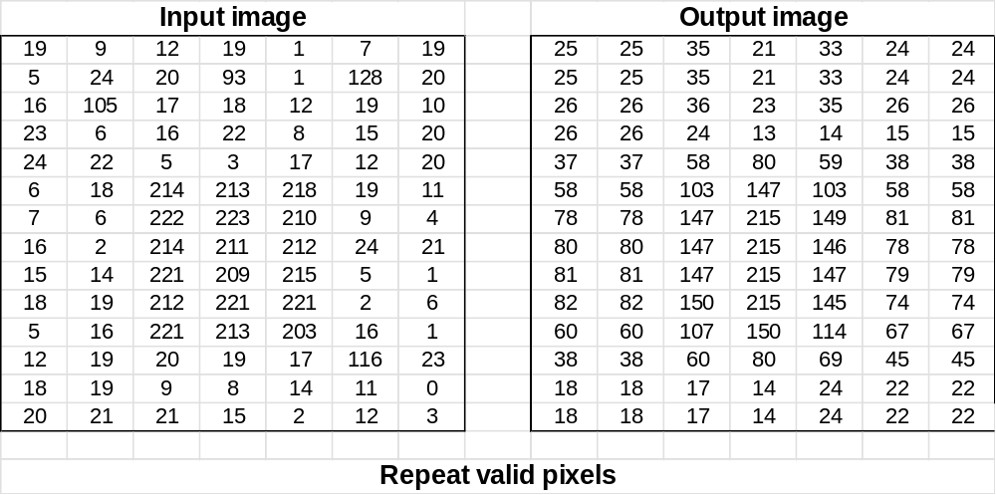
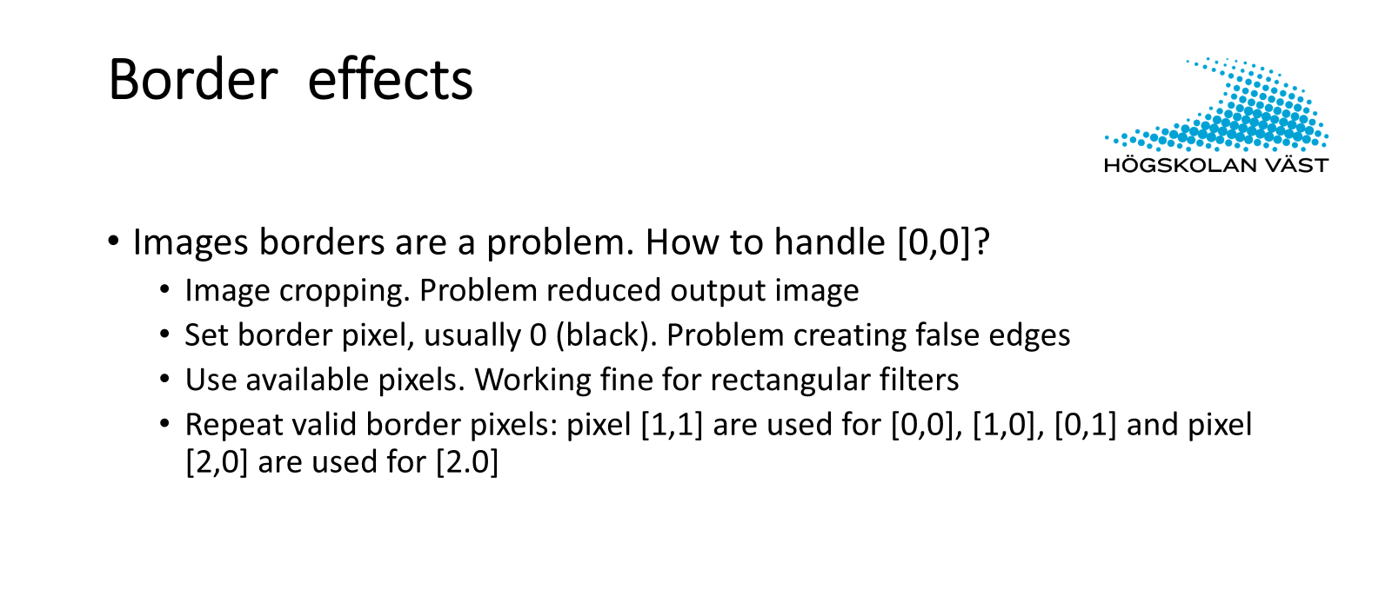
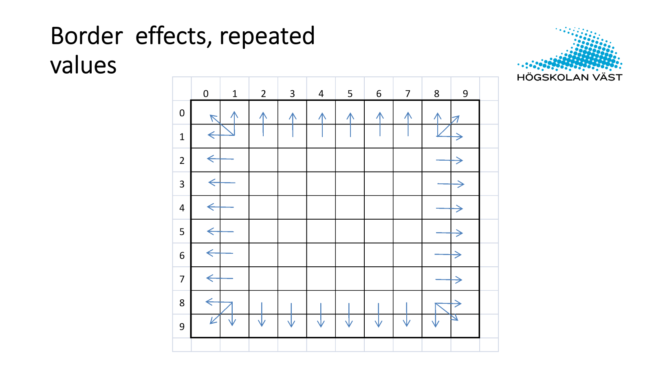
Handling the border

